Slide 1

Object-Oriented Programming Session: Week 5 Session 1 Instructor: Eric Pogue
Agenda:
Briefly Discuss FaceDraw and Mosaic Assignments
Introduce our Learning Objectives for the week

Slide 2
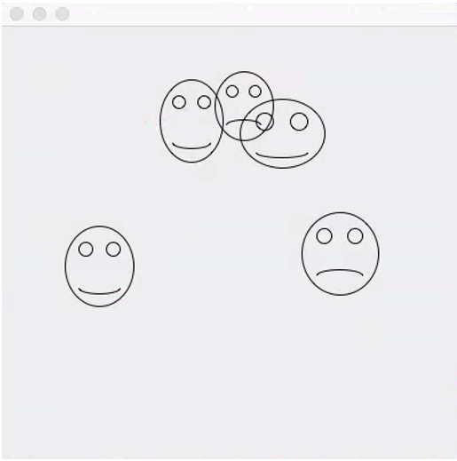
Briefly Discuss FaceDraw Assignment
FaceDraw and Learning Objectives: FaceDraw will be a challenging assignment this week. Our Learning Objects, Discussion, Lecture, and Examples will all be focused on helping you complete the assignment and learn the key concepts through delivering a concrete example.
In FaceDraw we will:
Create an application in Java that draws random faces on a window
Generate a random number between 3 & 10 and draw that many faces
Randomly generate reasonable and visually appealing face
Position itself to a reasonable size and location
Draw all faces so they are entirely within the window.
Draw each face with two eyes and a mouth.
The mouth should be randomly smiling, frowning, or in-between
Notes:
I’m looking for your feedback!

Slide 3
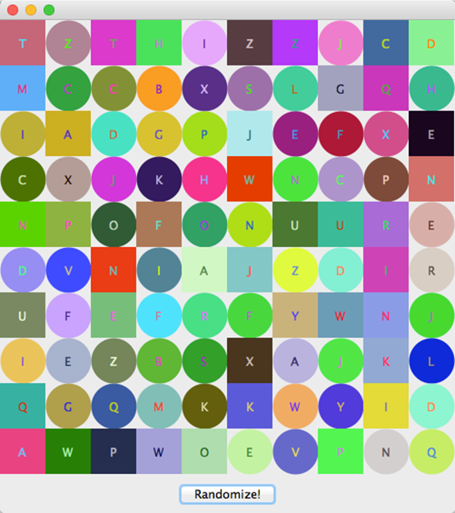
Briefly Discuss Mosaic Assignment
Mosaic and Learning Objectives: Mosaic will likely not be as challenging for you as FaceDraw was last week. Most of the elements that we will need for Mosaic we already learned last week. Therefore, this week’s objectives will be more forward looking.
In Mosaic we will:
Draw a set of random tiles
Draw random shapes, letters, and colors
Respond to a “Randomize” button
Display a new set of random tiles when the button is pushed
Implement a interesting and unique feature of our own choosing
Notes:
Less theory and more practical development…

Slide 4
Learning Objectives – Week 4
Understand how Java uses files for input and output (IO)
Design and implement a controller class to serialize (reads & writes) data to a text file
Explain software testing terms including unit, integration, user acceptance, performance testing, manual, automated, verification, validation, etc.
Understand the importance of testing and the criticality of finding/fixing defects early
Explain the purpose, syntax, and annotations of the various assert statements JUnit supports
Install JUnit onto your machine and execute a JUnit test on your application
Understand Java packages and compile a class so that it belongs to a particular package
Import a class you write that belongs to a particular package.
Identify reasons for using JAR (Java ARchive) files to group together related java classes
Create a JAR file that stores the contents of a particular package
Provide access to the classes in the JAR file for an application you write
Notes:
Write javadoc comments that describe the purpose, inputs, and outputs of classes and their components
Build javadoc documentation using Java's javadoc command-line tool
Quality Assurance vs. Testing
We test to find defects and/or to validate that we have not introduced new defects.
Defects are exponentially more expensive to fix the longer the exist.
Performance issues are often the most difficult and expensive defects to fix. They are often not found until the application if running under production load… which is often only when it is in production.
Unit - $200
Integration - $600
User Acceptance - $6,000
Production - $100,000+
The permutations of modern software features, data, tools, environments, etc. quickly becomes unmanageable. Testability needs to be goal of nearly all non-trivial applications.

Slide 5
Serialization and Writing/Reading Text Files (IO)
Serialization is an object-oriented programming term that means converting an object to a byte steam usually to be written to or read from a text or binary file.
To write to a text file:
Create a File object, feeding the file’s path to the File class constructor
Create a FileWriter to access the File
Create a BufferedWriter to write data to the FileWriter efficiently
Use BufferedWriter’s write and newLine functions to commit the data to the file.
To read from a text file:
Create a File object, feeding the file’s path to the File class constructor
Attach a Scanner object to it
Use Scanner’s readLine and hasNextLine functions to read the file
Notes:
A buffered writer or buffered stream efficiently organization reads and writes for optimal disk performance. The danger is that if there is a power failure (or someone accidentally kicks your power strip) you could lose data. It is good to “flush the buffer” at critical times when using a buffered writer on mission critical projects. There is little or no danger in using a buffered reader.
Binary files versus text files.

Slide 6
Testing

Slide 7
Unit testing can be done in two ways − manual testing and automated testing.
Manual Testing | Automated Testing
Executing a test cases manually without any tool support is known as manual testing. | Taking tool support and executing the test cases by using an automation tool is known as automation testing.
Time-consuming and tedious − Since test cases are executed by human resources, it is very slow and tedious. | Fast − Automation runs test cases significantly faster than human resources.
Huge investment in human resources − As test cases need to be executed manually, more testers are required in manual testing. | Less investment in human resources − Test cases are executed using automation tools, so less number of testers are required in automation testing.
Less reliable − Manual testing is less reliable, as it has to account for human errors. | More reliable − Automation tests are precise and reliable.
Non-programmable − No programming can be done to write sophisticated tests to fetch hidden information. | Programmable − Testers can program sophisticated tests to bring out hidden information.
Notes:
False positives versus valid defects found.
Manual Testing and Automated Testing can be supportive of each other.

Slide 8
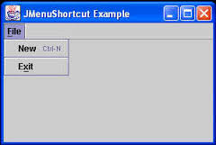
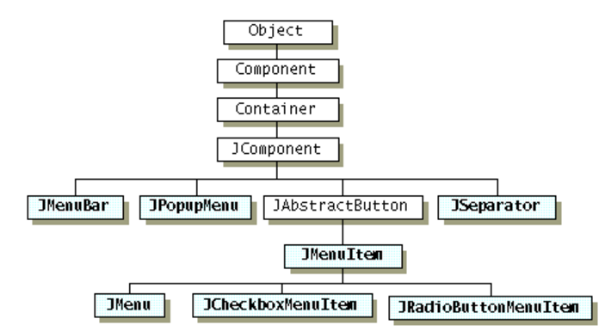
Menu Bars, Menus, and Menu Items
Java Menus are implemented with three related classes:
JMenuBar: the horizontal component across the top of the frame that contains Menus
JMenu: the user interface element that implements “File” in the image below
JMenuItem: the sub-items that can be selected from a Menu like “New” and “Exit” in the example below
The inheritance hierarchy for menu-related classes:
Notes:
Overview:
You create the JMenuBar. You create JMenu items that have captions (like File, Edit, etc.). You create JMenuItem objects that have captions (like Open, Close, Save, etc.) and add them to the JMenu’s. You associate ActionListener objects with each JMenuItem to describe what should happen when the JMenuItem is clicked. You add each JMenuItem to the JMenu. You add the JMenu to the JMenuBar. You then tell the frame to set its JMenuBar using setJMenuBar.

Slide 9
Mouse Clicking, Mouse Dragging, and Keystrokes
Nearly all graphical applications respond to Mouse Clicking and Keystrokes. Many applications also implement special behavior for Mouse Dragging. With Java in order to respond to these events we implement ActionListeners including:
MouseListener: Interface to implement to respond to Mouse Clicking
MouseMotionListener: Interface to implement to respond to Mouse Dragging
KeyListener: Interface to implement to respond to Keystrokes

Slide 10
MouseListener Interface
The MouseListener interface requires five methods to be implemented:
mouseClicked(MouseEvent e): Invoked when the mouse button has been clicked on a component
mouseEntered(MouseEvent e): Invoked when the mouse enters a component
mouseExited(MouseEvent e): Invoked when the mouse exits a component
mousePressed(MouseEvent e): Invoked when a mouse button has been pressed on a component
mouseReleased(MouseEvent e): Invoked when a mouse button has been released on a component
Notes:
Adapter Classes are an alternative to implementing all five methods. For our examples, I will be implementing all five, even if some of them seem unnecessary. You ware welcome to use Adapters in your assignments if you prefer.

Slide 11
MouseMotionListener Interface
The MouseMotionListener interface includes the following methods:
mouseDragged(MouseEvent e): Invoked when a mouse button is pressed on a component and then dragged
mouseMoved(MouseEvent e): Invoked when the mouse cursor has been moved onto a component but no buttons have been pushed
Notes:
.

Slide 12
KeyListener Interface
The KeyListener interface includes the following methods:
keyPressed(KeyEvent e): Invoked when a key has been pressed
keyReleased(KeyEvent e): Invoked when a key has been released
keyTyped(KeyEvent e): Invoked when a key has been typed
Notes:
.

Slide 13
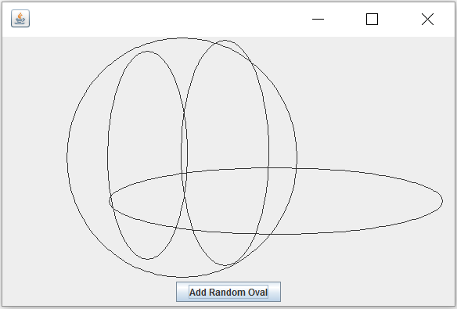
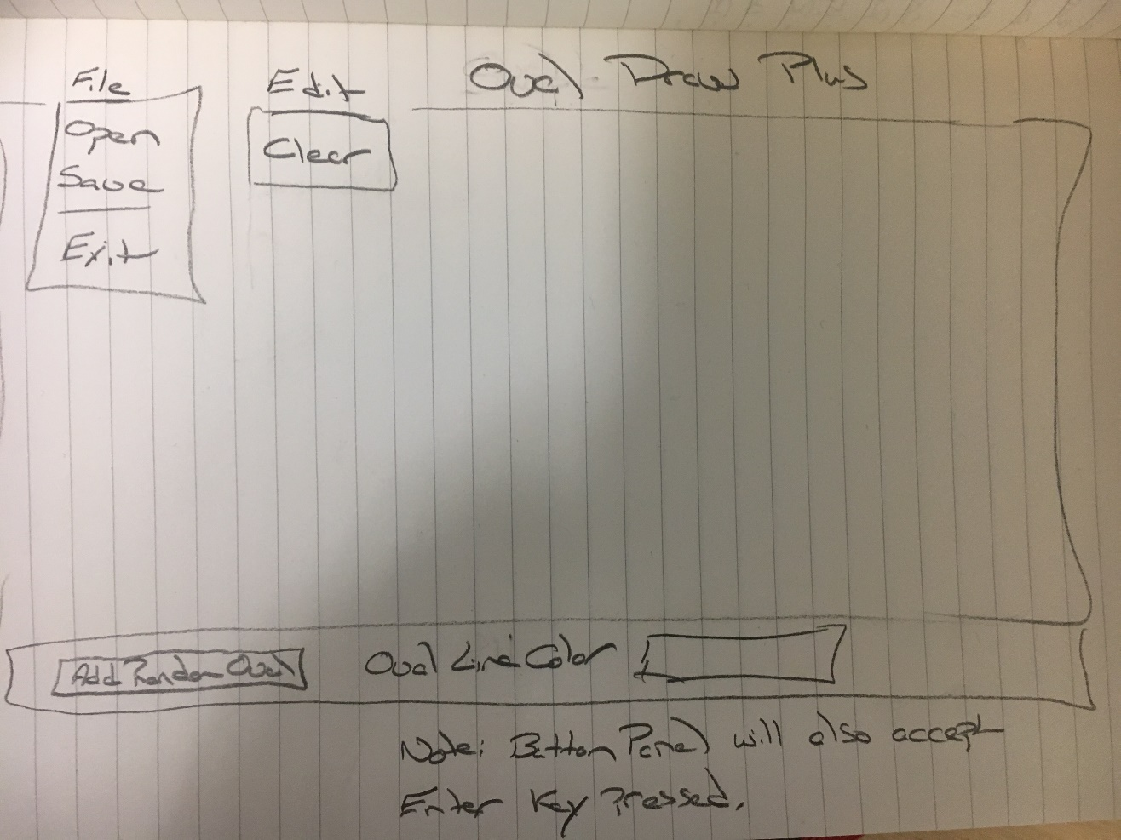
OvalDraw Plus User Interface Design
Notes:
Yes, this is often what a UI design looks like. In our first coding example this week, we are going to enhance the OvalDraw application to include menu elements to OvalDraw File|Exit and Edit|Clear. In addition, we will implement adding new random ovals with either a line color or a line weight. Finally, we will add file saving and opening and add the related Open and Save menu items to the application… more on that later.
I anticipate that we will also implement something with mouse clicking, mouse dragging, and timer also, but am uncertain what form that may take.

Slide 14
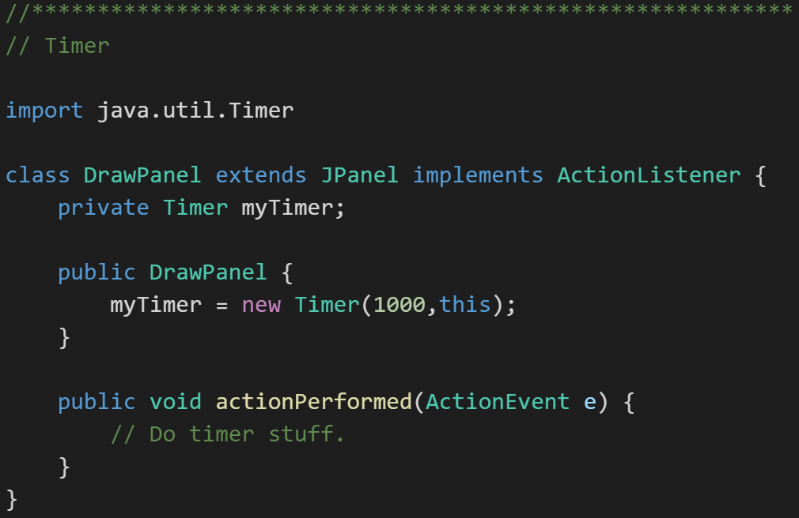
Timers
Timers are pretty straight forward to implement:
Implement the ActionListener Interface
Create a new timer passing in the object that implemented the ActionListener
Notes:
We will likely have a final programming example that will show some animation using timers. I’m not sure what form that example will take.

Slide 15
Model-View-Controller
Throughout our design and development activates we are working to create applications that segregate our View from our their Model & Data.
The Java environment makes this more challenging than it should be at times
Design tradeoffs need to be considered
The most import aspect of Model-View-Controller is that the Model has no visibility to the View

Slide 16
Learning Objectives – Week 4
Implement a menu system that enables the user to trigger a variety of actions in a familiar way
Implement code that responds to of events including: clicking the mouse, moving or dragging the mouse, and typing a key on the keyboard
Design multiple intuitive ways for a user to perform a particular task
Implement animation using a timer and a corresponding event handler
Create interactive applications that adhere to the Model-View-Controller pattern
Understand how Java achieves speedier input and output (IO) through a hierarchy file IO classes
Design and implement a controller class that outputs data to a text file
Design and implement a controller class that inputs data from a text file and builds a collection of objects from the data read data
Notes:
Any of these items would be a good candidate for your “interesting and unique” feature to add to your Mosaic assignment.

Slide 17
Serialization and Reading/Writing Text Files
Serialization is an object-oriented programming term that means converting an object to a byte steam usually to be written to or read from a file.
To write to a text file:
Create a File object, feeding the file’s path to the File class constructor
Create a FileWriter to access the File
Create a BufferedWriter to write data to the FileWriter efficiently
Use BufferedWriter’s write and newLine functions to commit the data to the file.
To read from a text file:
Create a File object, feeding the file’s path to the File class constructor
Attach a Scanner object to it
Use Scanner’s readLine and hasNextLine functions to read the file
Notes:
A buffered writer or buffered stream efficiently organization reads and writes for optimal disk performance. The danger is that if there is a power failure (or someone accidentally kicks your power strip) you could lose data. It is good to “flush the buffer” at critical times when using a buffered writer on mission critical projects. There is little or no danger in using a buffered reader.

Slide 18
OvalDraw Plus User Interface Design
Notes:
Our second programming example this week will be implementing Save & Open in our OvalDraw application.

Slide 19
Closing Comments & Next Steps
As promised, less theory and more development
Look for three follow-up development examples this week:
OvalDraw with User Experience Enhancements
OvalDraw reading and writing files
Something with Timers and Animation

Slide 20
End of Session
Course Number: CPSC-24500
Week: 4
Session: 1
Instructor: Eric Pogue

Slide 21
Object-Oriented Programming Session: Week 4 Session 2 Subject: More Interactive User Interfaces Instructor: Eric Pogue
Agenda:
Quick Review Learning Objectives we covered in Session 1
Overview of Session 2 Live Coding example and related Learning Objectives
Live User Interface Coding example
Review what we learned
Closing comments and next steps
Notes:
Quick note: I have changed the resolution of our videos starting with this session. I was using 1366x768 which made for more manageable video downloads, etc. As we head toward using Visual Studio and C#, I would like to move toward 1920x1080 to better allow us to see the integrated development environment (IDE). Let me know if the increased resolution causes difficulty in accessing or viewing the videos.

Slide 22
Learning Objectives – Week 4
Implement a menu system that enables the user to trigger a variety of actions in a familiar way
Implement code that responds to of events including: clicking the mouse, moving or dragging the mouse, and typing a key on the keyboard
Design multiple intuitive ways for a user to perform a particular task
Implement animation using a timer and a corresponding event handler
Create interactive applications that adhere to the Model-View-Controller pattern
Understand how Java achieves speedier input and output (IO) through a hierarchy file IO classes
Design and implement a controller class that outputs data to a text file
Design and implement a controller class that inputs data from a text file and builds a collection of objects from the data read data
Notes:
Any of these items would be a good candidate for your “interesting and unique” feature to add to your Mosaic assignment.

Slide 23
Learning Objectives – Week 4
Implement a menu system that enables the user to trigger a variety of actions in a familiar way
Implement code that responds to of events including: clicking the mouse, moving or dragging the mouse, and typing a key on the keyboard
Design multiple intuitive ways for a user to perform a particular task
Implement animation using a timer and a corresponding event handler
Create interactive applications that adhere to the Model-View-Controller pattern
Understand how Java achieves speedier input and output (IO) through a hierarchy file IO classes
Design and implement a controller class that outputs data to a text file
Design and implement a controller class that inputs data from a text file and builds a collection of objects from the data read data
Notes:
Any of these items would be a good candidate for your “interesting and unique” feature to add to your Mosaic assignment.

Slide 24
OvalDraw Plus User Interface Design
Notes:
Yes, this is often what a UI design looks like. In our first coding example this week, we are going to enhance the OvalDraw application to include menu elements to OvalDraw File|Exit and Edit|Clear. In addition, we will implement adding new random ovals with either a line color or a line weight. Finally, we will add file saving and opening and add the related Open and Save menu items to the application… more on that later.
I anticipate that we will also implement something with mouse clicking, mouse dragging, and timer also, but am uncertain what form that may take.

Slide 25
Learning Objectives – Week 4
Implement a menu system that enables the user to trigger a variety of actions in a familiar way
Implement code that responds to of events including: clicking the mouse, moving or dragging the mouse, and typing a key on the keyboard
Design multiple intuitive ways for a user to perform a particular task
Implement animation using a timer and a corresponding event handler
Create interactive applications that adhere to the Model-View-Controller pattern
Understand how Java achieves speedier input and output (IO) through a hierarchy file IO classes
Design and implement a controller class that outputs data to a text file
Design and implement a controller class that inputs data from a text file and builds a collection of objects from the data read data
Notes:
Any of these items would be a good candidate for your “interesting and unique” feature to add to your Mosaic assignment.

Slide 26
Closing Comments & Next Steps
I’m trying to get ups in a learning pattern where we:
See the concepts and patterns (theory)
Watch them being used in a “real-life” example
Implement a solution using what we have learned
Let me know how this is working, and how we can continue to improve

Slide 27
End of Session
Course Number: CPSC-24500
Week: 4
Session: 2
Instructor: Eric Pogue

Slide 28
Object-Oriented Programming Session: Week 4 Session 3 Subject: Clicks, Drags, Timers, and Animations Instructor: Eric Pogue
Agenda:
Quick Review Learning Objectives we covered in Session 1
Overview of Session 3 Live Coding example and related Learning Objectives
Clicks and drags… with FaceDraw-ish solution
Short break
Timers and animation
Review what we learned and week 4 assignment as time allows
Final comment & questions
Notes:
Start Recording!

Slide 29
Learning Objectives – Week 4
Implement a menu system that enables the user to trigger a variety of actions in a familiar way
Implement code that responds to of events including: clicking the mouse, moving or dragging the mouse, and typing a key on the keyboard
Design multiple intuitive ways for a user to perform a particular task
Implement animation using a timer and a corresponding event handler
Create interactive applications that adhere to the Model-View-Controller pattern
Understand how Java achieves speedier input and output (IO) through a hierarchy file IO classes
Design and implement a controller class that outputs data to a text file
Design and implement a controller class that inputs data from a text file and builds a collection of objects from the data read data
Notes:
Any of these items would be a good candidate for your “interesting and unique” feature to add to your Mosaic assignment.

Slide 30
Learning Objectives – Week 4
Implement a menu system that enables the user to trigger a variety of actions in a familiar way
Implement code that responds to of events including: clicking the mouse, moving or dragging the mouse, and typing a key on the keyboard
Design multiple intuitive ways for a user to perform a particular task
Implement animation using a timer and a corresponding event handler
Create interactive applications that adhere to the Model-View-Controller pattern
Understand how Java achieves speedier input and output (IO) through a hierarchy file IO classes
Design and implement a controller class that outputs data to a text file
Design and implement a controller class that inputs data from a text file and builds a collection of objects from the data read data
Review week 4 assignment as time allows

Slide 31
Mouse Clicking, Mouse Dragging, and Keystrokes
Nearly all graphical applications respond to Mouse Clicking and Keystrokes. Many applications also implement special behavior for Mouse Dragging. With Java in order to respond to these events we implement ActionListeners including:
MouseListener: Interface to implement to respond to Mouse Clicking
MouseMotionListener: Interface to implement to respond to Mouse Dragging
KeyListener: Interface to implement to respond to Keystrokes

Slide 32
MouseListener Interface
The MouseListener interface requires five methods to be implemented:
mouseClicked(MouseEvent e): Invoked when the mouse button has been clicked on a component
mouseEntered(MouseEvent e): Invoked when the mouse enters a component
mouseExited(MouseEvent e): Invoked when the mouse exits a component
mousePressed(MouseEvent e): Invoked when a mouse button has been pressed on a component
mouseReleased(MouseEvent e): Invoked when a mouse button has been released on a component
Notes:
Adapter Classes are an alternative to implementing all five methods. For our examples, I will be implementing all five, even if some of them seem unnecessary. You ware welcome to use Adapters in your assignments if you prefer.
The mouseClicked method is the most often overridden. The mousePressed and mouseReleased are most often used with dragging.
import java.awt.event.MouseListener;
import java.awt.event.MouseEvent;
public void mousePressed(MouseEvent e) {}
public void mouseReleased(MouseEvent e) {}
public void mouseEntered(MouseEvent e) {}
public void mouseExited(MouseEvent e) {}
public void mouseClicked(MouseEvent e) {}
addMouseListener(this);
MouseEvent:
int getX();
int getY();

Slide 33
MouseMotionListener Interface
The MouseMotionListener interface includes the following methods:
mouseDragged(MouseEvent e): Invoked when a mouse button is pressed on a component and then dragged
mouseMoved(MouseEvent e): Invoked when the mouse cursor has been moved onto a component but no buttons have been pushed
Notes:
Note: Dragging is quite challenging to implement… and not that often utilized.
import java.awt.event.MouseMotionListener;
import java.awt.event.MouseEvent;
MouseMotionListener
public void mouseDragged(MouseEvent e) {}
public void mouseMoved(MouseEvent e) {}
addMouseMotionListener(this);

Slide 34
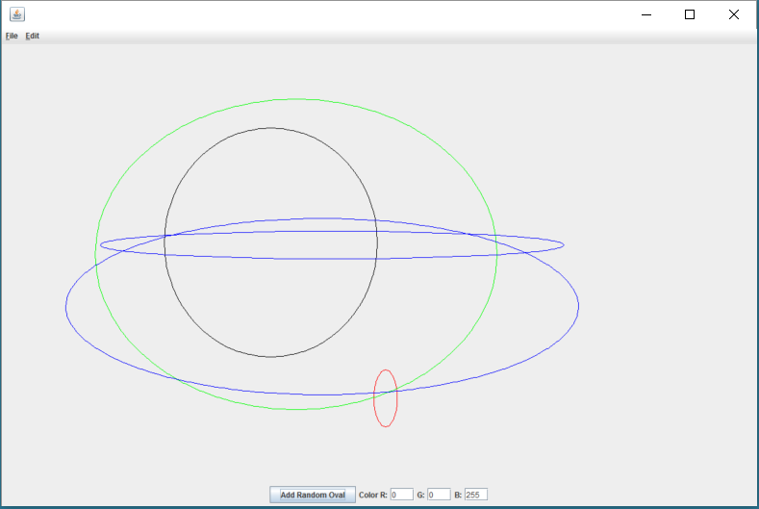
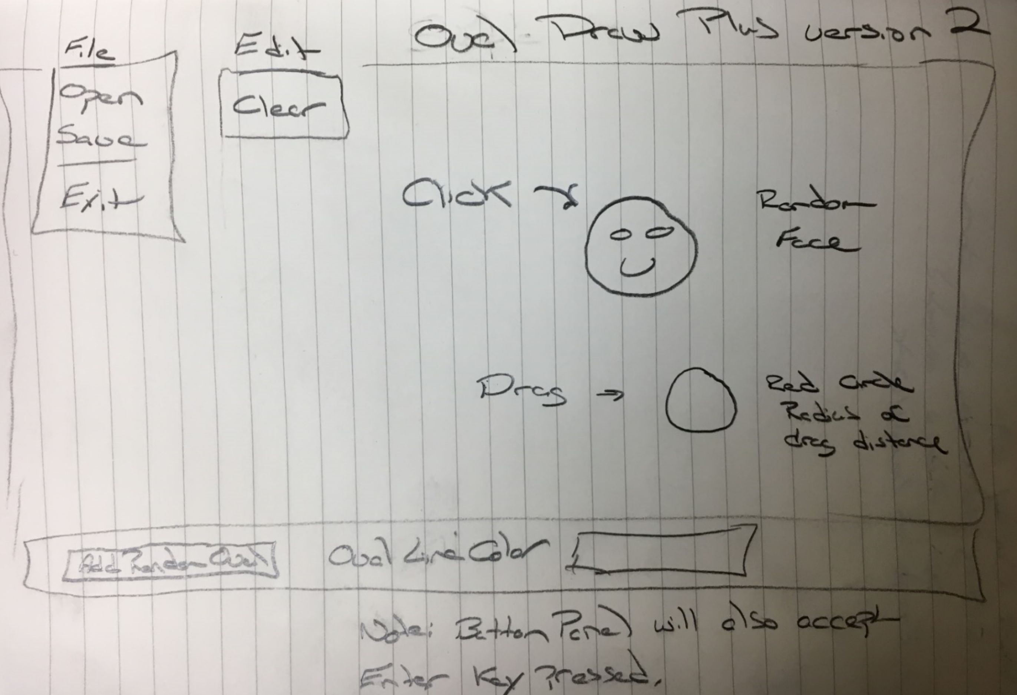
OvalDraw Plus With Clicking and Dragging
Notes:
Enhance OvalDraw to include drawing a random face (similar to FaceDraw) with clicked and to draw a red circle with a radius of the drag distance when the mouse is dragged.

Slide 35
OvalDraw Plus Enhancements Steps
Clone our current Git repository
Copy original files over to OvalDrawPlus folder
Compile library and ShapeDraw code
Quickly test application
Review ShapeDraw code… focus on ShapeDrawPanel
Minor code cleanup… and “compress” classes that we will not be looking at today
Implement MouseListener Interface
Implement MouseMotionListener Interface
Add random oval on click
Implement red circle on mouse drag… this is challenging
Implement FaceDraw on click… and remove step nine’s random oval draw
Review, final question, and commit/push

Slide 36
Quick Break
Course Number: CPSC-24500
Week: 4
Session: 3
Instructor: Eric Pogue

Slide 37
Timers
Timers are pretty straight forward to implement:
Implement the ActionListener Interface
Create a new timer passing in the object that implemented the ActionListener
Notes:
We will likely have a final programming example that will show some animation using timers. I’m not sure what form that example will take.
import java.util.Timer;
private Timer animationTimer;
animationTimer = new Timer(1000,this);
public void actionPerformed(ActionEvent e) {
System.out.println("actionPerformed(ActionEvent e)");
}

Slide 38
OvalDraw Plus Timer and Animated Faces
Implement ActionListener on ShapeDrawPanel
Implement Timer
Implent updateMouth in FaceDraw
Implement ArrayList for FaceDraw objects
Update FaceDraw mouths and redraw

Slide 39
Learning Objectives – Week 4
Implement a menu system that enables the user to trigger a variety of actions in a familiar way
Implement code that responds to of events including: clicking the mouse, moving or dragging the mouse, and typing a key on the keyboard
Design multiple intuitive ways for a user to perform a particular task
Implement animation using a timer and a corresponding event handler
Create interactive applications that adhere to the Model-View-Controller pattern
Understand how Java achieves speedier input and output (IO) through a hierarchy file IO classes
Design and implement a controller class that outputs data to a text file
Design and implement a controller class that inputs data from a text file and builds a collection of objects from the data read data
Review week 4 assignment as time allows

Slide 40
End of Session
Course Number: CPSC-24500
Week: 4
Session: 3
Instructor: Eric Pogue

Slide 41
Object-Oriented Programming Session: Week 4 Session 4 Subject: Thursday Lunch Discussion & Lecture Instructor: Eric Pogue
Agenda – Thursday, April 13 from noon to 1pm:
Good natured chatting and banter ~10min
Quick introductions and how are you feeling about the course… start, stop, continue ~10min
Discussion, questions & answers
Week 4 Assignment Helpful Hints with MosaicLite
Notes:
Start Recording!
Note: I am looking forward to the discussion mostly and will continue to complete the MosaicLite activities after 1pm as needed. Don’t hesitate to drop off as your schedule requires. I will send out the link to the session after it is complete.

Slide 42
Introductions, Feedback, and Q&A
Name and one thing you are planning for the Easter weekend
Start, stop, continue:
What new thing should we start doing for the class?
What is one thing that we should stop doing?
What is one thing that we are doing that we should definitely keep doing?
Questions & Answers
Notes:
This is your time… how can I help.

Slide 43
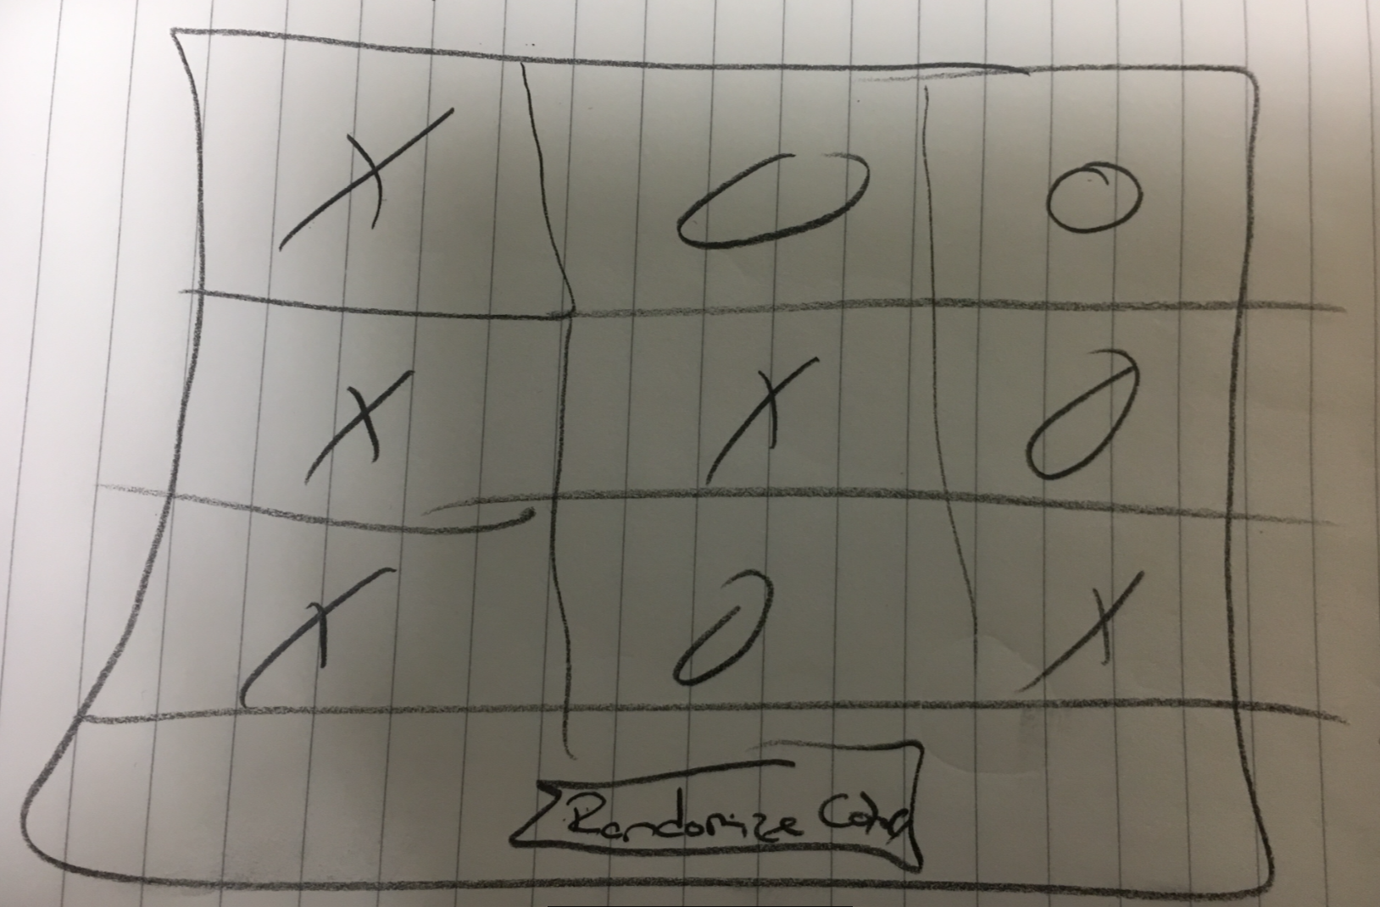
MosaicLite
Implement a 3x3 grid of colored tiles
Implement tiles with a random background color
Paint an X or an O on the tile
Create a Randomize button
Randomize the colors when the button is pushed
Randomize the X or O when the button is pushed

Slide 44
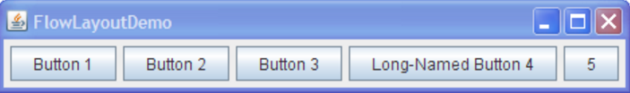
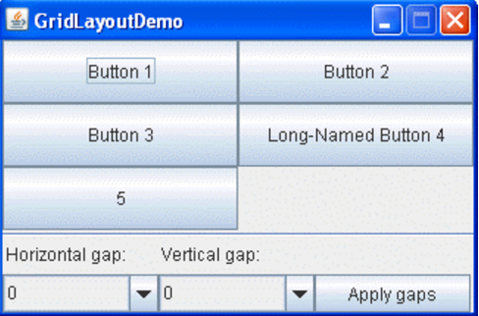
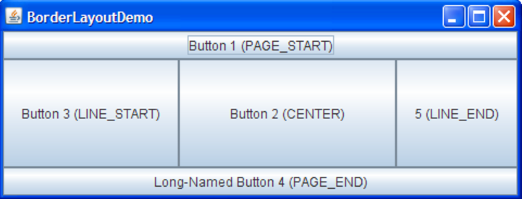
Layout Managers (continued)
Layout Managers arrange controls on the screen so they are visually appealing. We will be focusing on three very common Layout Managers:
FlowLayout: Arranges components left to right, top to bottom. When a FlowLayout runs out of room horizontally on a row, it places the next component as far left as it can go on the row below.
BorderLayout: Arranges components in NORTH, SOUTH, EAST, WEST, and CENTER sections.
GridLayout: Arranges components in an Excel-like table of rows and columns.
Notes:
This is different from environments where developers (or designers) layout screens pixel by pixel (like Visual Basic for example). With modern UIs that need to fit in all types of sizes and orientations, layout managers are a necessity.
Several AWT and Swing classes provide layout managers for general use:
BorderLayout
BoxLayout
CardLayout
FlowLayout
GridBagLayout
GridLayout
GroupLayout
SpringLayout

Slide 45
MosaicLite
JFrame
JPanel… grid & tile
JButton
GridLayout
BorderLayout
FlowLayout
ActionListener & ActionEvent
Random
Graphics
Color
Font
Notes:
See application source code!

Slide 46
Closing Comments
I hope the example helps…
Give the holiday weekend, I am going to delay our file writing & reading activities until week 5
Have a great weekend!

Slide 47
End of Session
Course Number: CPSC-24500
Week: 4
Session: 4
Instructor: Eric Pogue

